Slide 1
Capstone Project-2
Bike Sharing Demand Prediction
Team Member
Mayur Prakash Parande
Shubham Shrivastava
Praful Mahendra Gedam

Slide 2
Problem Description
Currently Rental bikes are introduced in many urban cities for the enhancement of mobility comfort. It is important to make the rental bike available and accessible to the public at the right time as it lessens the waiting time. Eventually, providing the city with a stable supply of rental bikes becomes a major concern. The crucial part is the prediction of bike count required at each hour for the stable supply of rental bikes.

Slide 3
Data Description
The dataset contains weather information (Temperature, Humidity, Windspeed, Visibility, Dewpoint, Solar radiation, Snowfall, Rainfall), the number of bikes rented per hour and date information.

Slide 4
Attribute Information
Date : year-month-day
Rented Bike count - Count of bikes rented at each hour
Hour - Hour of he day
Temperature-Temperature in Celsius
Humidity - %
Windspeed - m/s
Visibility - 10m
Dew point temperature - Celsius
Solar radiation - MJ/m2
Rainfall - mm
Snowfall - cm
Seasons - Winter, Spring, Summer, Autumn
Holiday - Holiday/No holiday
Functional Day - NoFunc(Non Functional Hours), Fun(Functional hours)

Slide 5
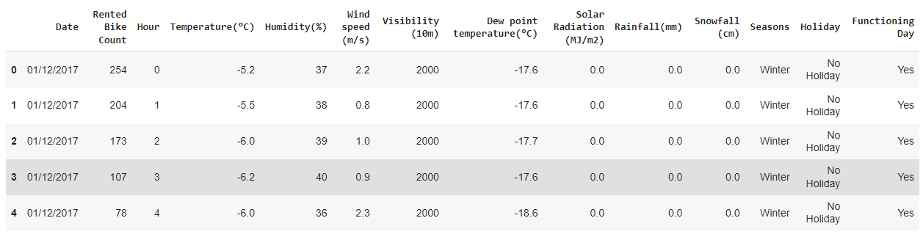
Encoding of Dataset

Slide 6
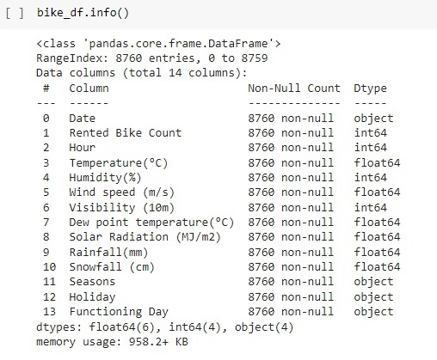
Let's check the result of data type

Slide 7
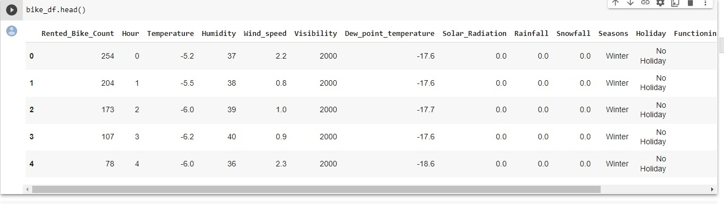
Data Describe

Slide 8
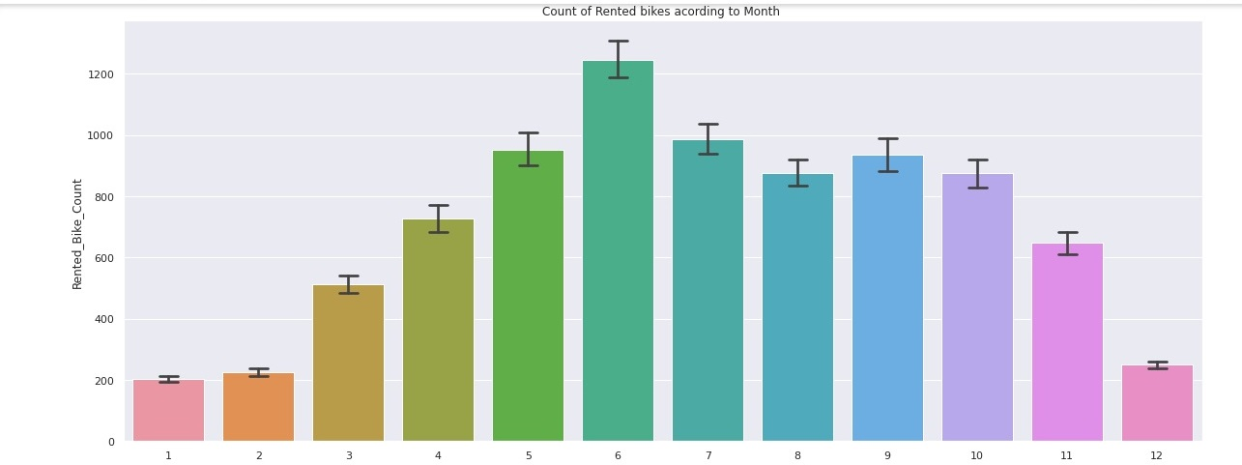
Count of Rented bikes according to month

Slide 9
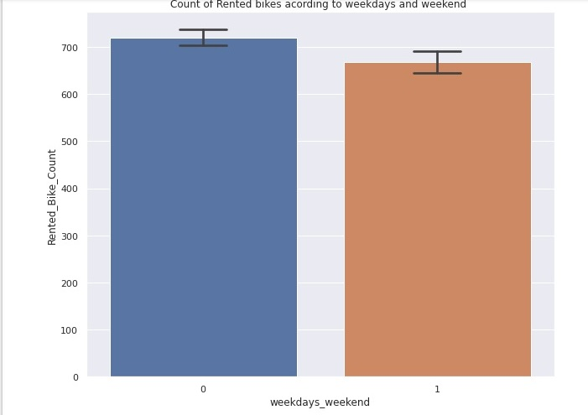
Count of Rented bikes according to weekdays and weekend

Slide 10
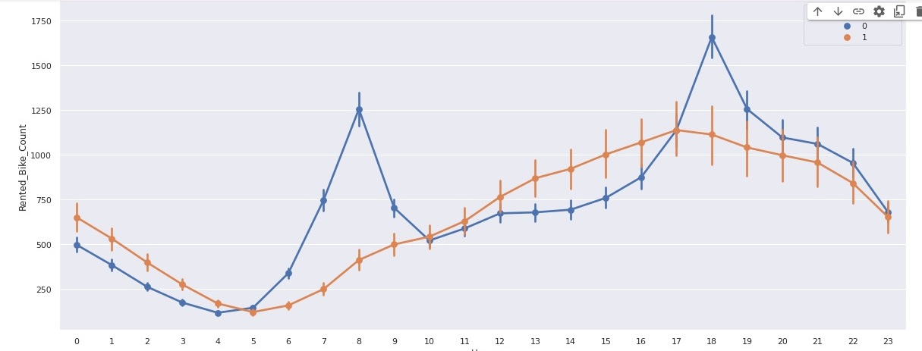
This Chart is Show Count of Rented bikes according to weekdays and weekend

Slide 11
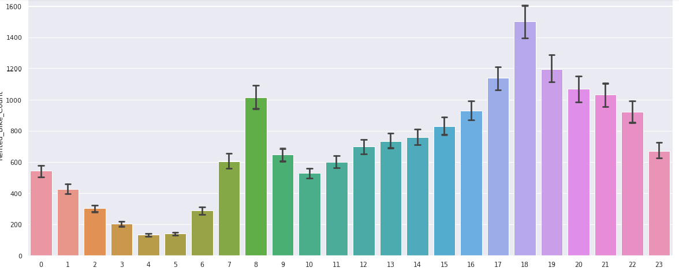
Count of Rented of Bikes according to Hours

Slide 12
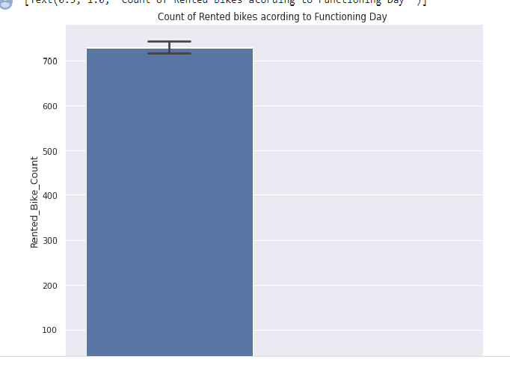
Count of Rented of Bikes according to Functiononing Day

Slide 13
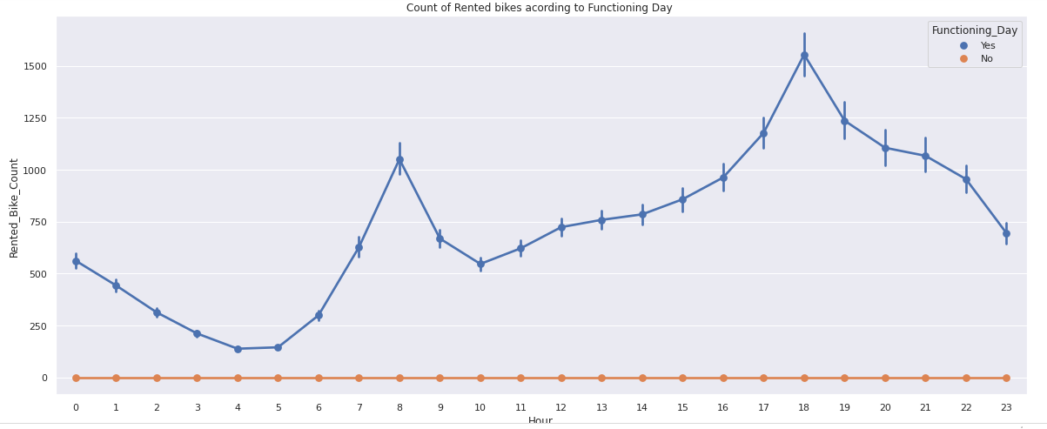
This Chart is show Count of Rented of Bikes according to Functioning Day

Slide 14
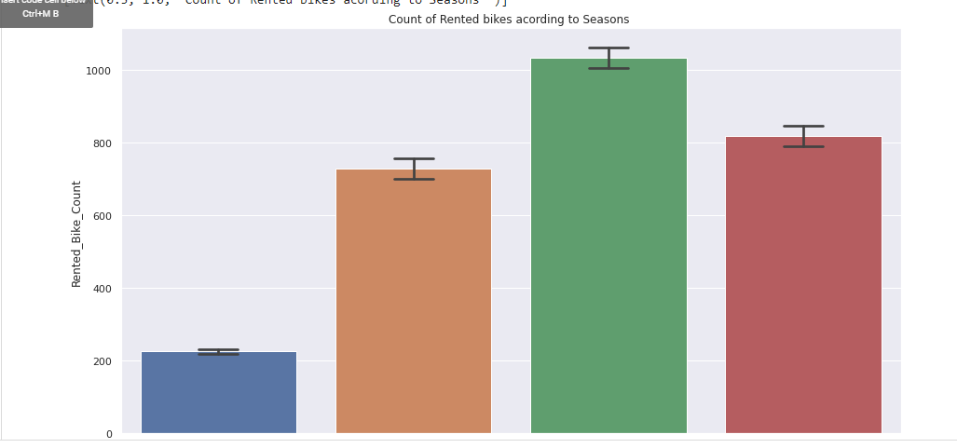
Count of Rented of Bikes according to Seasons

Slide 15
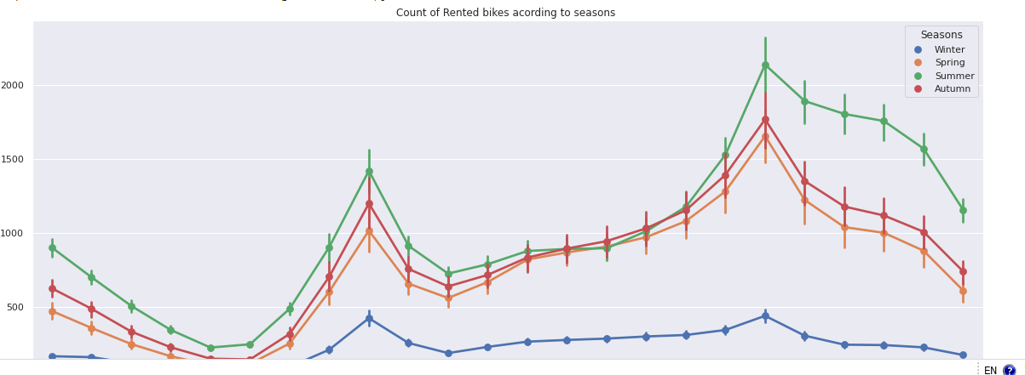
This chart is show Count of Rented of Bikes according to Seasons

Slide 16
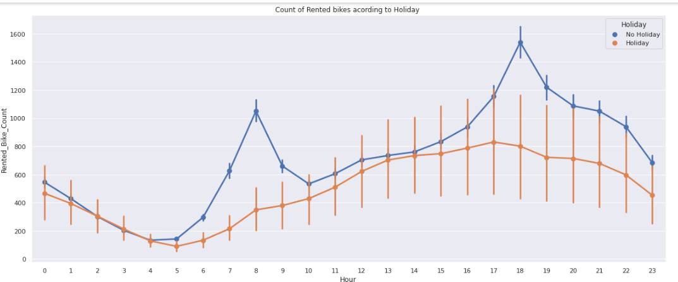
Encoding of Dataset

Slide 17
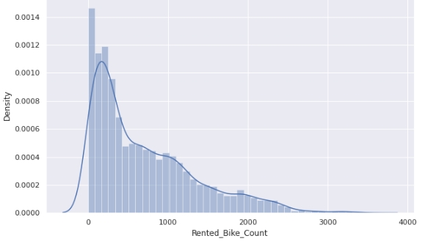
analyze the distribution of all numerical features

Slide 18
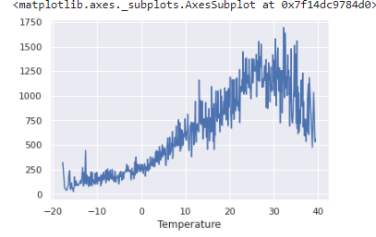
analyze the distribution of all numerical features

Slide 19
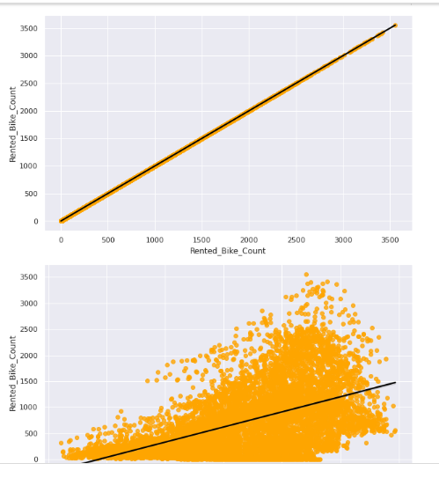
Regression plot for all the numerical features

Slide 20
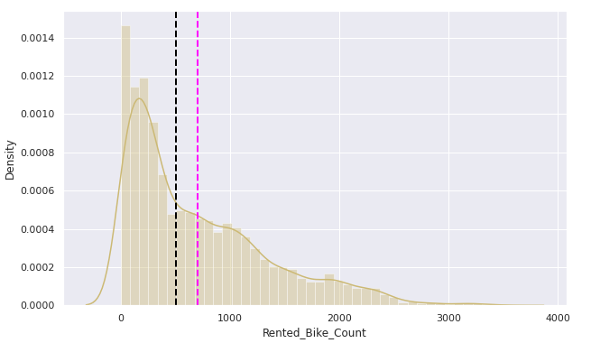
Applying square root to Rented Bike Count to improve skewness

Slide 21
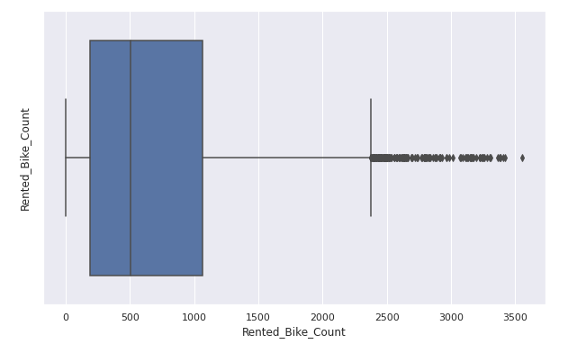
Boxplot of Rented Bike Count to check outliers

Slide 22
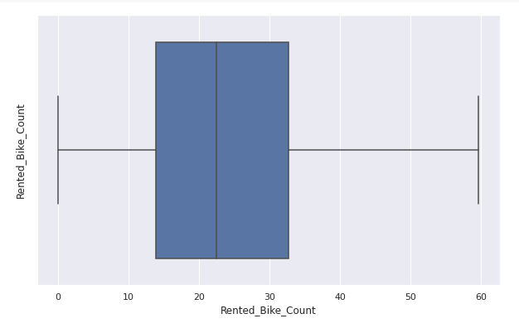
After applying sqrt on Rented Bike Count check wheatear we still have outliers

Slide 23
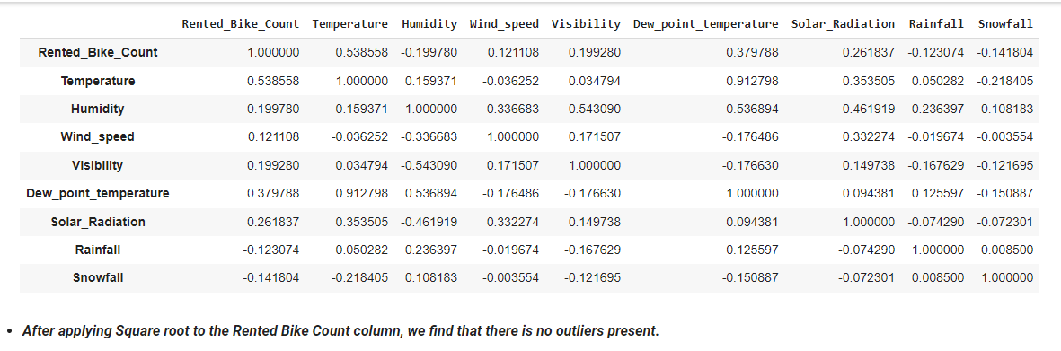
After applying Square root to the Rented Bike Count column, we find that there is no outliers present.

Slide 24
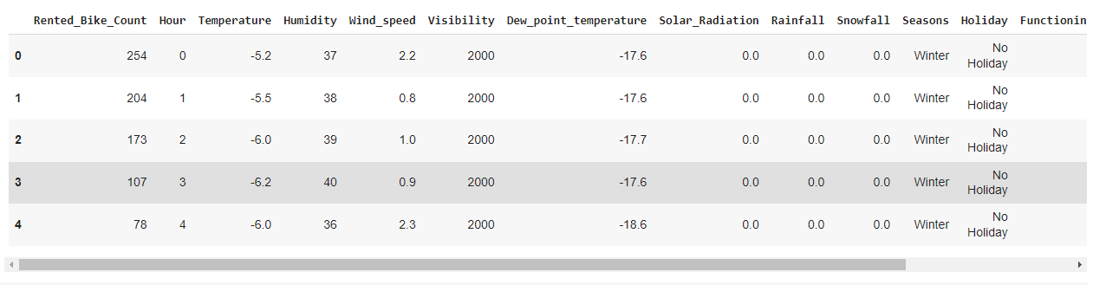
import the module

Slide 25
Train Test split for regression

Slide 26
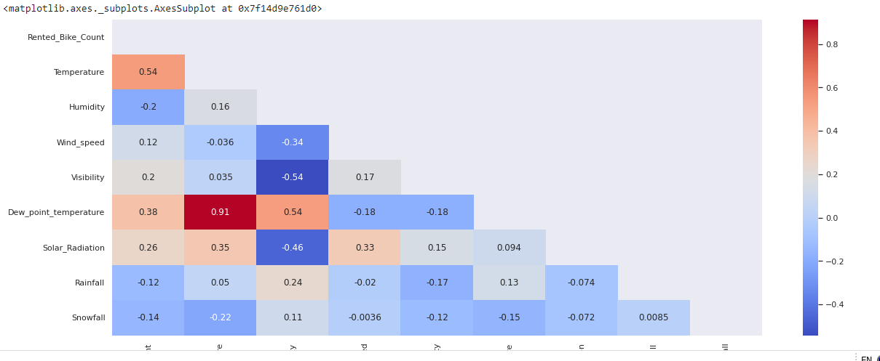
Heat Map :- Plot the Correlation matrix

Slide 27
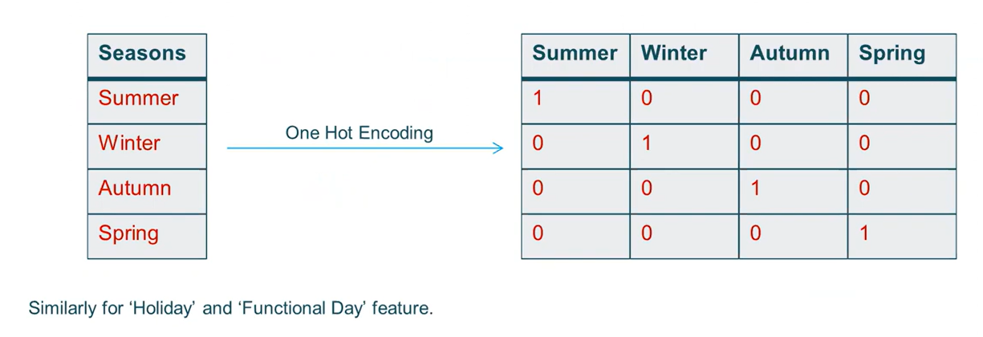
Features Transformation
Due of presence of categorical feature we cant feed data directly in ML algorithm. We need to transform categorical features that have strings datatype to numerical datatype. For which we have used One-hot encoding and label encoding for categorical features.

Slide 28
Challenges
Large Dataset to handle.
Need to plot lot of Graphs to analyses.
Feature engineering
Feature selection
Optimizing the model
Carefully tuned Hyperparameters as it affects the R2 score.

Slide 29
Conclusion
In the given dataset there was no strong linear relation between dependent variable ‘Rented Bike Count’ and independent features. That’s why Linear regression model and its other regularization variant models didn’t performed well.
Out of all models we apply Decision tree and Random forest model are most accurate. Reason for this are no specific relation between features and large data.
Random Forest performed best as it is an ensemble model and result from multiple decision trees is average out to give prediction.

Slide 30
Functioning day is the most influencing feature and temperature is the second place for Linear regressor.
Temperature is the most important feature for Decision Tree , Random Forest and Gradient Boosting regressor.
Function day is the most important feature and winter is the second most for XG Boost regressor.
RMSE Comparisons:
Linear regressor RMSE:5.96
Data frame for later comparisons.RMSE:5.72
The Feature temperature is on the top list for all the regressors expect XG Boost.
XG Boost is acting different from all the regressors as it is considering it is considering whether it is winter or not and is it a working day or not Though winter is also a function of temperature only but it seems this trick of XG Boot is giving better result.
XG Boost Regressor has the Least Root Mean Squared Error, So it can be considered as the best model for given problem.

Slide 31
Thankyou

